Slide 1
A Hybrid Network Analysis and
Machine Learning Model for
Enhanced Financial Distress Prediction.
BY OUR TEAM:
NATARAJ SWETHA -21X41A4238
BITRA GOWTHAM -21X41A4207
SHAIK LAL AHAMAD -22X45A4207
SHAIK MAHABOOB BASHA -22X45A4209
GUIDED BY : DAMARAJU VARA PRASADA PADMAJA

Slide 2
ABSTRACT
This research presents a hybrid model combining network analysis and machine learning to enhance financial distress prediction. Utilizing ensemble learning methods such as Voting Classifier, Random Forest, AdaBoost Classifier, and Stacking Classifier, the model improves predictive accuracy and robustness. The dataset consists of 86 features and 3,672 samples, capturing key financial indicators. Network analysis is employed for feature extraction, enriching the dataset with structural insights. By integrating advanced machine learning techniques and ensemble strategies, the model effectively differentiates between financially distressed and non-distressed entities. The study demonstrates notable improvements in prediction performance, providing valuable insights for financial analysts and decision-makers in assessing financial health risks.
Keywords: Ensemble learning, voting classifiers and Random Forest algorithms.

Slide 3
EXISTING SYSTEM
The existing system uses a dataset of financial data from Iranian SMEs. Existing financial distress prediction systems primarily rely on traditional financial indicators and machine learning algorithms, such as Support Vector Machines (SVM), Decision Tress, to assess potential risks. These methods typically use standard features like profitability ratios, liquidity measures, and leverage indicators to train models like Support Vector Machines (SVM) and other classification algorithms. However, these approaches may lack depth in capturing the intricate relationships and interactions between companies. The existing system integrates network analysis, which offers valuable insights into financial linkages, significantly enhancing predictive accuracy by incorporating these network-based features alongside traditional financial indicators. Despite the variation in datasets, both approaches integrate network analysis with machine learning algorithms to improve prediction accuracy.

Slide 4
DISADVANTAGES
1. Limited Feature Scope: Traditional systems rely solely on standard financial indicators, potentially missing nuanced risk factors that can affect financial stability.
2. Surface-Level Analysis: Methods focusing only on profitability ratios and leverage may not capture deeper, complex relationships between financial metrics and distress signals.
3. Neglected Interactions: Existing models often overlook the interactions between different financial indicators, which can provide critical insights into financial health.
4. Inflexibility to Dynamic Factors: Traditional approaches might not adapt well to rapidly changing financial environments, reducing their accuracy in real-time distress prediction.

Slide 5
PROPOSED SYSTEM
The proposed system integrates hybrid network analysis with machine learning to enhance financial distress prediction. It employs ensemble learning techniques, specifically voting classifiers and Random Forest algorithms, to analyse a comprehensive dataset comprising 86 features and 3,672 samples. By combining advanced machine learning methods with robust ensemble strategies, the system aims to improve prediction accuracy. It focuses on distinguishing between financially distressed and non-distressed entities, offering deeper insights into financial health indicators and significantly advancing predictive performance for financial analysts and decision-makers.

Slide 6
ADVANTAGES
1. Enhanced Accuracy: By leveraging ensemble learning techniques such as voting classifiers and Random Forest algorithms, the system improves prediction accuracy through the combination of multiple models' strengths.
2. Robust Analysis: The use of a comprehensive dataset with 86 features and 3,672 samples allows for a thorough analysis of financial distress indicators, providing a deeper understanding of financial health.
3. Advanced Insights: The integration of hybrid network analysis with machine learning delivers more nuanced insights into financial health, benefiting financial analysts and decision-makers.
4. Enhanced Predictive Performance: The system's advanced techniques offer a significant boost in predictive performance, aiding in more accurate financial distress forecasting.

Slide 7
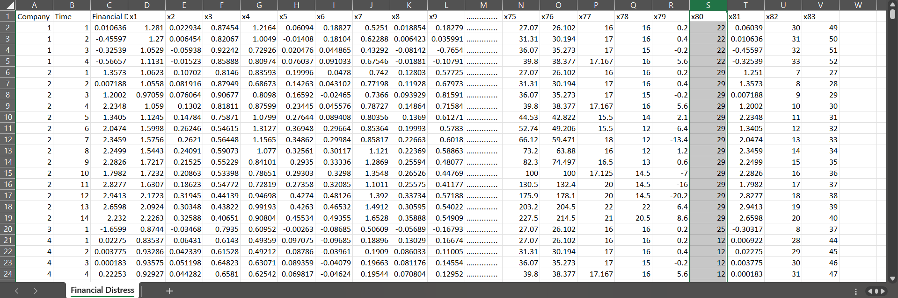
FINANCIAL DISTRESS PREDICTION DATASET

Slide 8
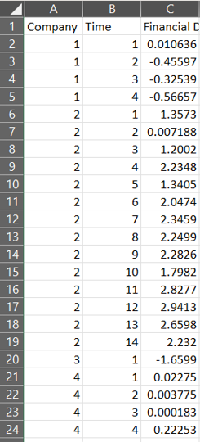
Dataset explanation
First column: Company represents sample companies.
Second column: Time shows different time periods that data belongs to. Time series length varies between 1 to 14 for each company.
Third column: The target variable is denoted by "Financial Distress" if it is greater than -0.50 the company should be considered as healthy (0). Otherwise, it would be regarded as financially distressed (1).
Fourth column to the last column: The features denoted by x1 to x83, are some financial and non-financial characteristics of the sampled companies. These features belong to the previous time period, which should be used to predict whether the company will be financially distressed or not (classification).
For example, company 1 is financially distressed at time 1 but company 2 is still healthy at time 14.

Slide 9
HARDWARE & SOFTWARE REQUIREMENTS
SOFTWARE REQUIREMENS
Operating System : Windows 7/8/10
Server-side Script : HTML, CSS, Bootstrap & JS
Programming Language : Python
Libraries : Flask, Pandas, MySQL. Connector, OS, Numpy
IDE/Workbench : PyCharm, VS-Code
Technology : Python 3.6+
Server Deployment : Xampp Server
Database : MySQL

Slide 10
HARDWARE & SOFTWARE REQUIREMENTS
HARDWARE REQUIREMENTS
Processor - I5/Intel Processor
RAM - 8GB (min)
Hard Disk - 160 GB
Key Board - Standard Windows Keyboard
Mouse - Two or Three Button Mouse
Monitor - Any

Slide 11
MODULES
User:
View data:
In the view data, the user will View the dataset for modelling.
Input Model:
The user must provide input values for the certain fields in order to get results.
View Results:
User view’s the generated results from the model.
View score:
Here user have ability to view the accuracy in %

Slide 12
System:
Working on dataset:
System checks for data whether it is available or not and load the data in csv files.
Pre-processing:
Data need to be pre-processed according the models it helps to increase the accuracy of the model and better information about the data.
Training the data:
After pre-processing the data will split into two parts as train and test data before training with the given algorithms.
Model Building
To create a model that predicts the personality with better accuracy, this module will help user.
Generated Score:
Here user view the score in %

Slide 13
Literature Survey
TITLE | AUTHORS | YEAR | OUTCOMES | DESCRIPTION
Systematic Review of Financial Distress Identification using Artificial Intelligence Methods | Dovilė Kuizinienė, Tomas Krilavičius , Damaševičius , and Rytis Maskeliūnas | 2022 | AI-based models improve distress prediction but lack explainability; hybrid models could enhance accuracy. | Focused on: AI-driven financial distress prediction models. Future Scope: Develop interpretable AI models, integrate non-financial data, and test hybrid models.
Deep learning models for bankruptcy prediction using textual disclosures | Mai Feng, Tian Shaonan, Lee Chihoon, Ma Ling | 2018 | Deep learning models outperform traditional models when combining textual & numerical data. | Focused on: Using deep learning for bankruptcy prediction from financial reports. Future Scope: Improve model interpretability and test on global datasets.
On the determinants and prediction of corporate financial distress in India | S.Sehgal, RK.Mishra, F.Deisting,R.Vashisht, | 2021 | Identified five key financial ratios; ML models (SVM & ANN) outperformed the logit model. | Focused on: Comparing financial distress prediction using ML and traditional models. Future Scope: Expand to sector-specific models and macroeconomic factors.

Slide 14
Literature Survey
TITLE | AUTHORS | YEAR | OUTCOMES | DESCRIPTION
Do Traditional Financial Distress Prediction Models Predict Early Warning Signs? | Sumaira Ashraf, Elisabete G. S. Félix, Zélia Serrasqueiro | 2019 | The probit model had the best distress prediction, while Z-score was better for insolvency. | Focused on: Evaluating traditional distress models in Pakistan. Future Scope: Enhance models with real-time market indicators for early detection.
The Effect of Financial Ratios on the Possibility of Financial Distress in Indonesia | Rudolf Lumbantobing | 2020 | Debt and liquidity ratios were significant predictors; ROA had a complex relationship. | Focused on: Financial ratios and distress prediction in Indonesian firms. Future Scope: Study industry-specific impacts and external economic conditions.
The Impact of Corporate Social Responsibility on Financial Distress | M. Farooq, A. Noor, F. Qureshi | 2022 | CSR has a significant negative impact on financial distress, benefiting both shareholders and stakeholders | Focused on: Examining CSR’s role in reducing financial distress. Future Scope: Develop CSR frameworks for financial stability in emerging markets.

Slide 15
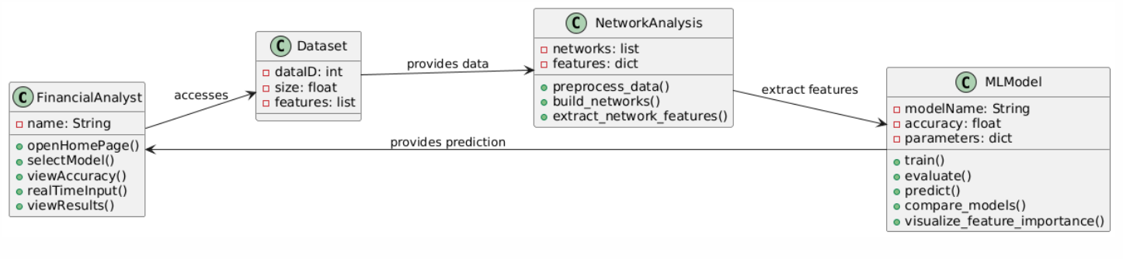
CLASS DIAGRAM
UML DIAGRAMS

Slide 16
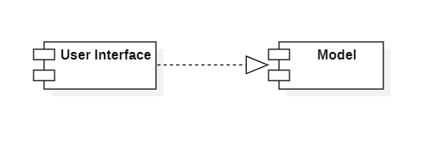
COMPONENT DIAGRAM

Slide 17
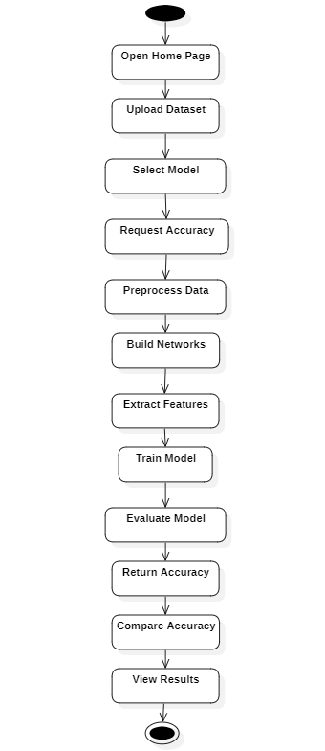
ACTIVITY DIAGRAM

Slide 18
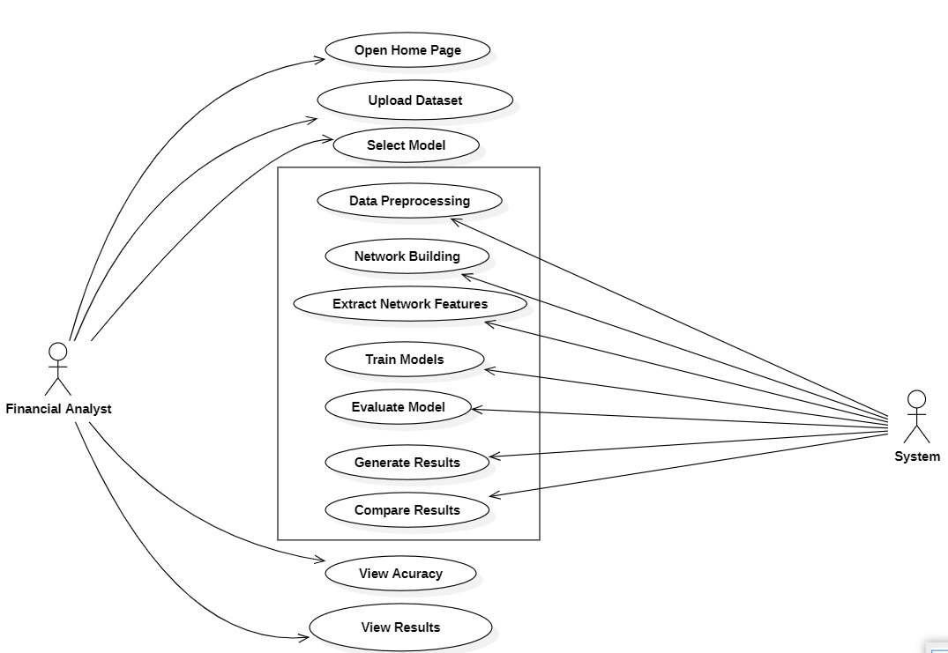
USECASE DIAGRAM

Slide 19
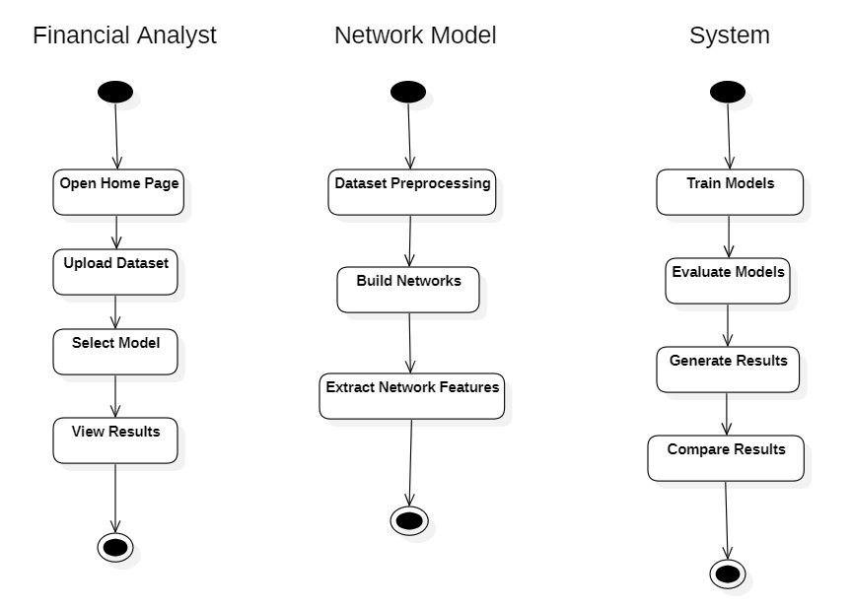
STATE MACHINE DIAGRAM

Slide 20
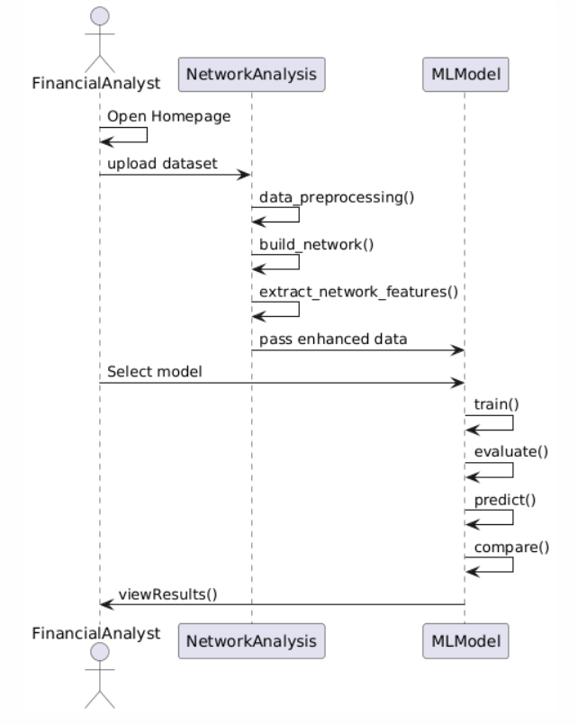
SEQUENCE DIAGRAM

Slide 21
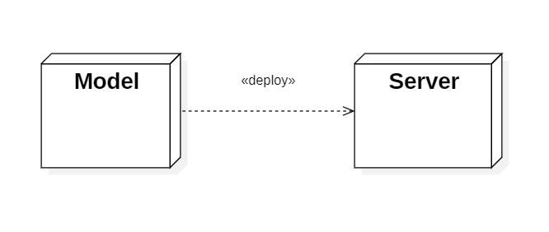
DEPLOYMENT DIAGRAM

Slide 22
METHODOLOGY
Data Collection:
The dataset includes financial and non-financial data from Kaggle, sourced from audited statements, with 83 features and 3672 samples.
2. Data Preprocessing:
This involved handling missing values, removing duplicates, and selecting key features for financial distress prediction. Correlation coefficients for all 83 variables were calculated, identifying the top five.
3.Network Construction and Analysis
What is Network Analysis?
It helps identify relationships between companies based on financial data.
Instead of looking at companies separately, we analyze how they are connected financially.
Type of Network Used in Prediction:
1. Similarity-Based Network
Finds companies with closely related financial patterns based on key indicators.
Builds a weighted graph where stronger links mean higher similarity.

Slide 23
4.Model Training:
Five different machine learning algorithms were used for model training:
Random Forest
Gradient Boosting
AdaBoost
Voting Classifier
Slacking Classifier
5.Evaluation and Performance Analysis:
The models were trained and evaluated using metrics such as accuracy, precision, recall, F-Score, and ROC curves.
The performance of the implemented models was computed for each scenario, and a comparative analysis was conducted to determine the best performing model for financial distress prediction.

Slide 24
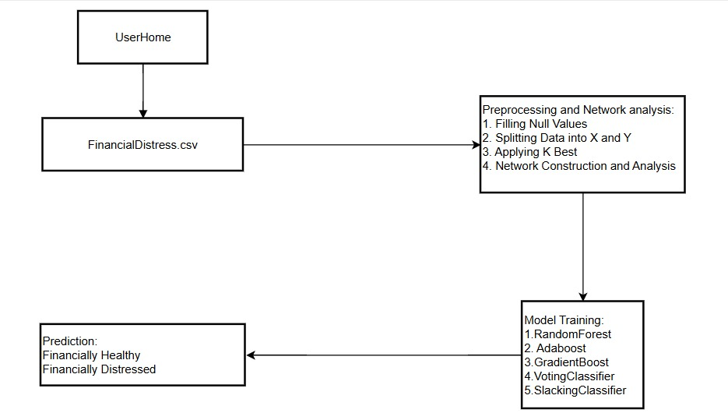
ARCHITECTURE

Slide 25
RANDOM FOREST ALGORITHM:
STEP 1: Bootstrap Sampling (Bagging)
Randomly select multiple subsets of the dataset with replacement.
STEP 2: Train Multiple Decision Trees
Each tree is trained on a different subset.
Only a random subset of features is considered for splitting at each node.
STEP 3: Make Predictions from Each Tree
Classification: Majority voting (most frequent class).
Regression: Averaging (mean of predictions).
STEP 4: Final Output
Aggregated result from all trees gives the final prediction.

Slide 26
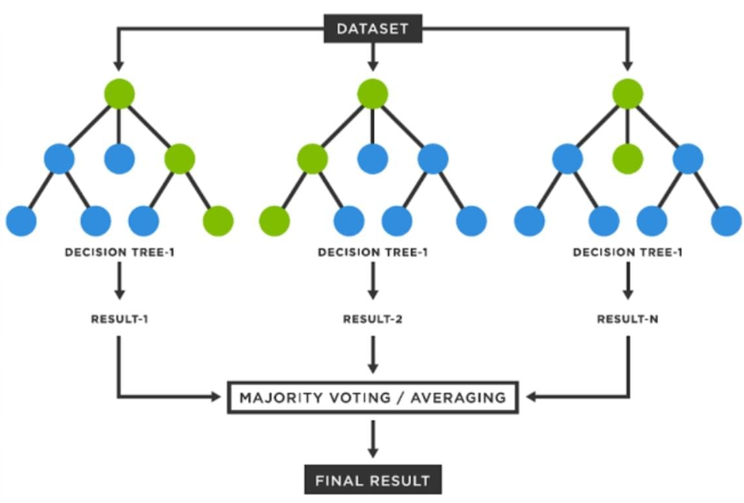
ARCHITECTURE

Slide 27
Gradient Boosting Algorithm
STEP 1: Initialize with a Weak Model
Start with a simple model, typically a Decision Tree with few splits.
STEP 2: Calculate Errors (Residuals)
Compute the difference between the actual values and predicted values (residual errors).
STEP 3: Train a New Tree on Residuals
The next tree is trained to correct the previous model's errors.
STEP 4: Update Predictions
Combine previous predictions with new ones using a learning rate (small step adjustments).
STEP 5: Final Output
The final model is a weighted sum of all trees, making predictions more accurate.

Slide 28
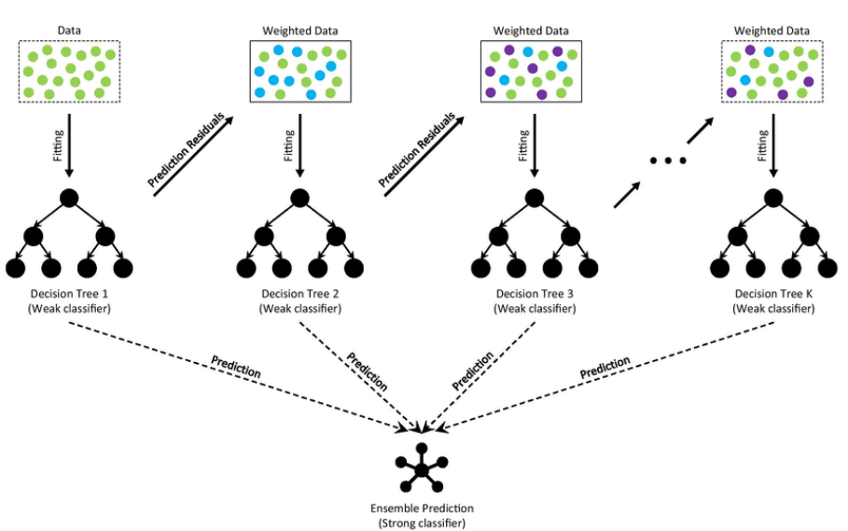
ARCHITECTURE

Slide 29
AdaBoost Algorithm
STEP 1: Initialize Equal Weights
Assign equal weights to all training samples.
STEP 2: Train a Weak Learner (Decision Tree)
A simple classifier (typically a shallow decision tree) is trained.
STEP 3: Calculate Errors & Update Weights
Misclassified samples get higher weights (more focus).
Correctly classified samples get lower weights (less focus).
STEP 4: Train Next Weak Learner
A new weak model is trained, focusing more on previously misclassified samples.
STEP 5: Final Prediction
Combine all weak learners' outputs using a weighted sum (strong classifier).

Slide 30
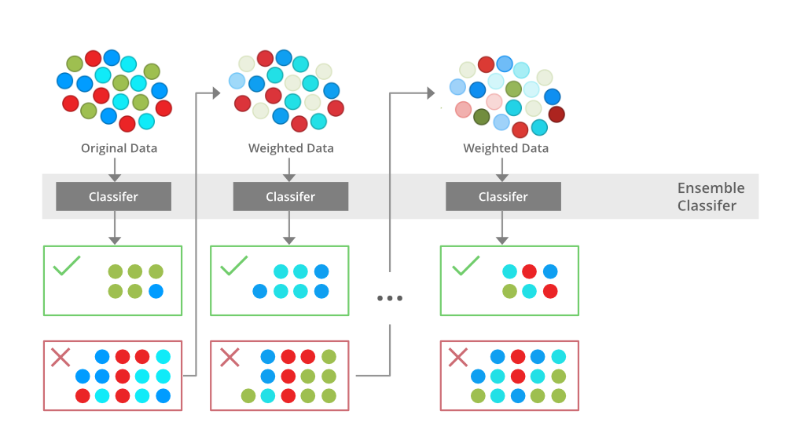
ARCHITECTURE

Slide 31
Voting Classifier Algorithm
STEP 1: Select Multiple Base Models
Choose different classifiers (e.g., Decision Tree, SVM, Random Forest, Logistic Regression).
STEP 2: Train Each Classifier on the Same Data
Every model is trained independently using the training dataset.
STEP 3: Combine Predictions Using Voting
Hard Voting: Each model votes for a class, and the majority class is selected.
Soft Voting: Average of predicted probabilities is taken, and the class with the highest probability is selected.
STEP 4: Final Prediction
The class label with the most votes (Hard Voting) or the highest average probability (Soft Voting) is the final output.

Slide 32
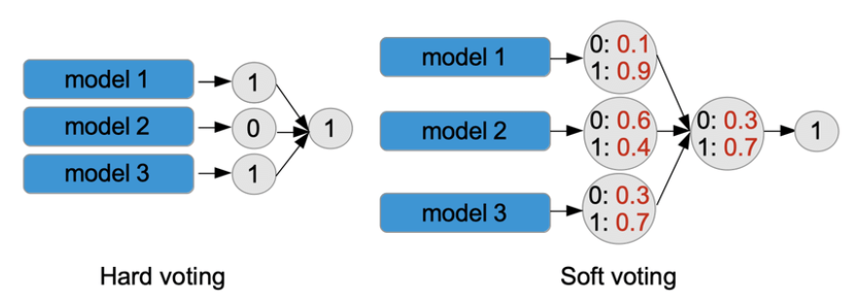
ARCHITECTURE

Slide 33
Stacking Classifier Algorithm
STEP 1: Choose Multiple Base Models
Select diverse models (e.g., Decision Tree, SVM, Random Forest, Logistic Regression).
STEP 2: Train Base Models on Training Data
Each model is trained independently on the same dataset.
STEP 3: Generate Predictions from Base Models
The outputs (predictions) of these models become the input features for the next model.
STEP 4: Train a Meta-Model (Blender Model)
A higher-level model (e.g., Logistic Regression) learns from the base models’ predictions.
The meta-model combines the strengths of all base models.
STEP 5: Final Prediction
The meta-model makes the final decision based on the base models’ outputs.

Slide 35
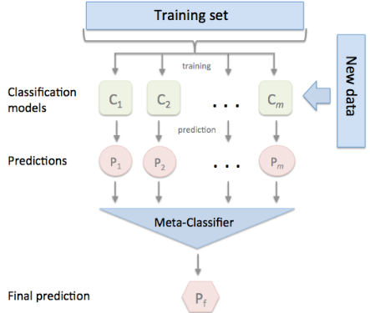
ARCHITECTURE

Slide 36

SAMPLE SCREENSHOTS
Home Page: Home page of the project

Slide 37

About Page: Here is the information Related Financial Distress.

Slide 38
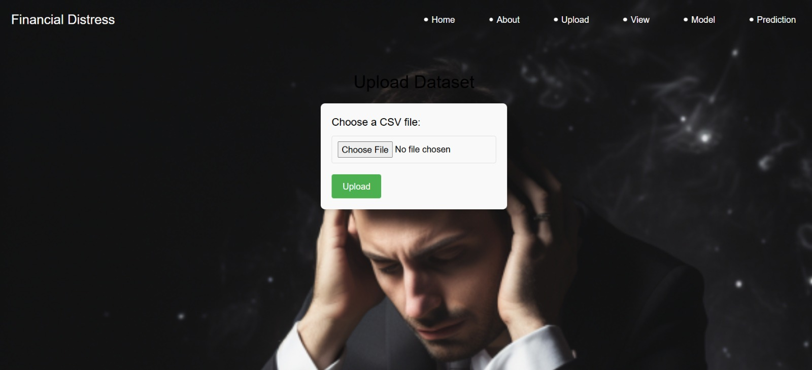
Upload Data: Here User can upload the Dataset.

Slide 39
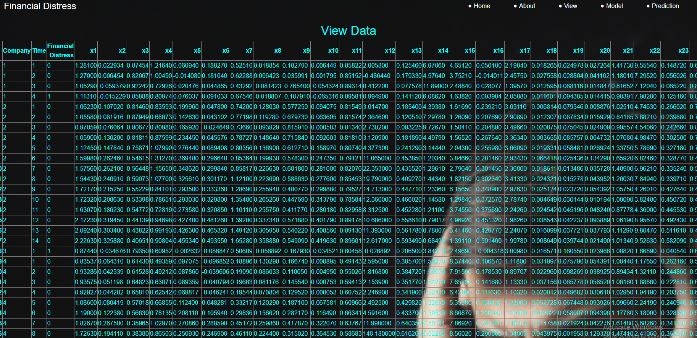
View Data: Here User can view the Dataset.

Slide 40

Model Selection: We’re training the algorithm to see which one has the best score.

Slide 41
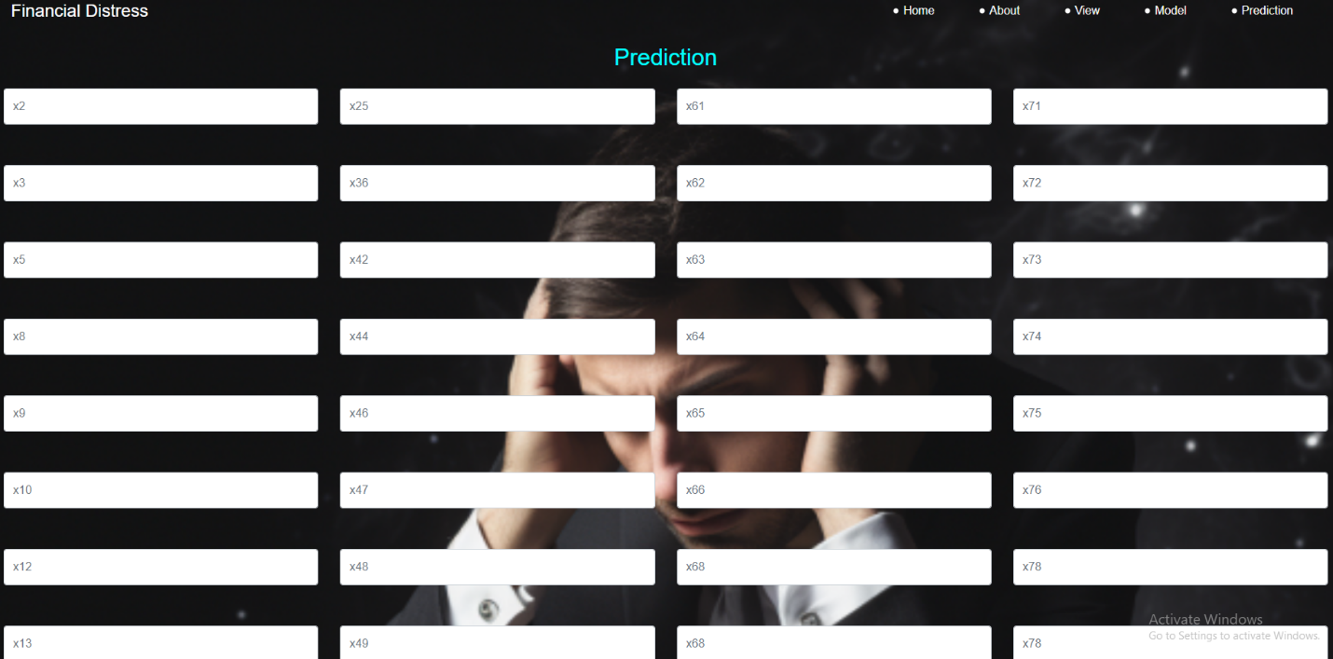
Prediction: User can give a input and view The Predicted Result.

Slide 42


